Slide 1
C400 Project Simple Model Assemblages for Website Identification
By Charles Hu

Slide 2

Objective
Develop models to classify website of origin given web traffic samples
No explicit identifying features
Sender IP/port
Receiver IP/port
Encrypted payload

Slide 3
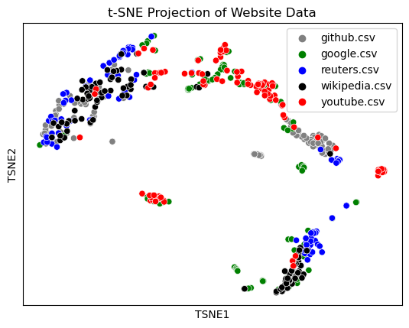
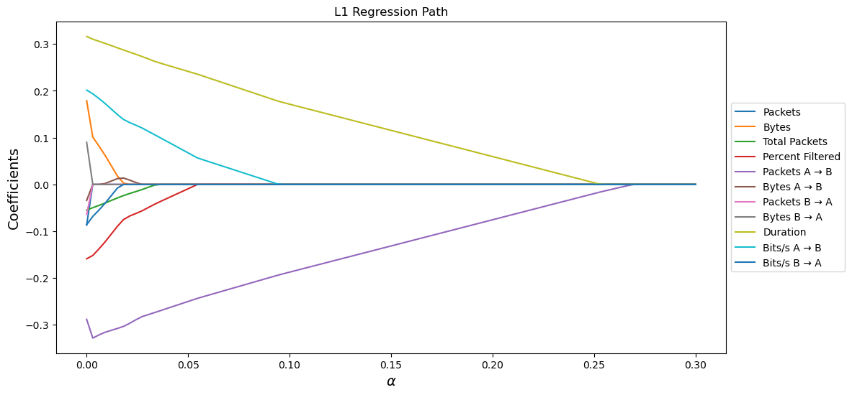
Data Collection
Extract TCP streams via Wireshark
506 streams across 5 websites
17 features per stream
Explicit feature selection not used

Slide 4
Methodology
6 simple model designs, 10 ensemble model designs
Avoid overly complex model designs
Leverage ensemble theory
Baseline model: Logistic regression

Slide 5
Results
Top 3 Simple Models
Model Name | Training Accuracy | Testing Accuracy
Decision Tree | 0.96782 | 0.83333
KNN | 0.77475 | 0.62745
Log. Reg. | 0.61139 | 0.58826
Top 5 Models Overall
Model Name | Training Accuracy | Testing Accuracy
AdaBoost – DTC | 1.0 | 0.89216
Bagging – DTC | 0.98762 | 0.87255
Bagging – KNN | 0.93317 | 0.85294
Random Forest | 0.98762 | 0.84314
Soft Voting | 0.97772 | 0.84314
}
Top 3 Ensemble Models
Model Name | Training Accuracy | Testing Accuracy
AdaBoost – DTC | 1.0 | 0.89216
Bagging – DTC | 0.98762 | 0.87255
Bagging – KNN | 0.93317 | 0.85294

Slide 6
Conclusion
Best performing model: AdaBoost DTC
Top performing models involved DTC/KNN
Future work:
Expand sample size
Feature selection
Expand/revisit used models

